Slide 1

BUSINESS OF SPORTS
Student's Name
Institution of Affiliation

Slide 2
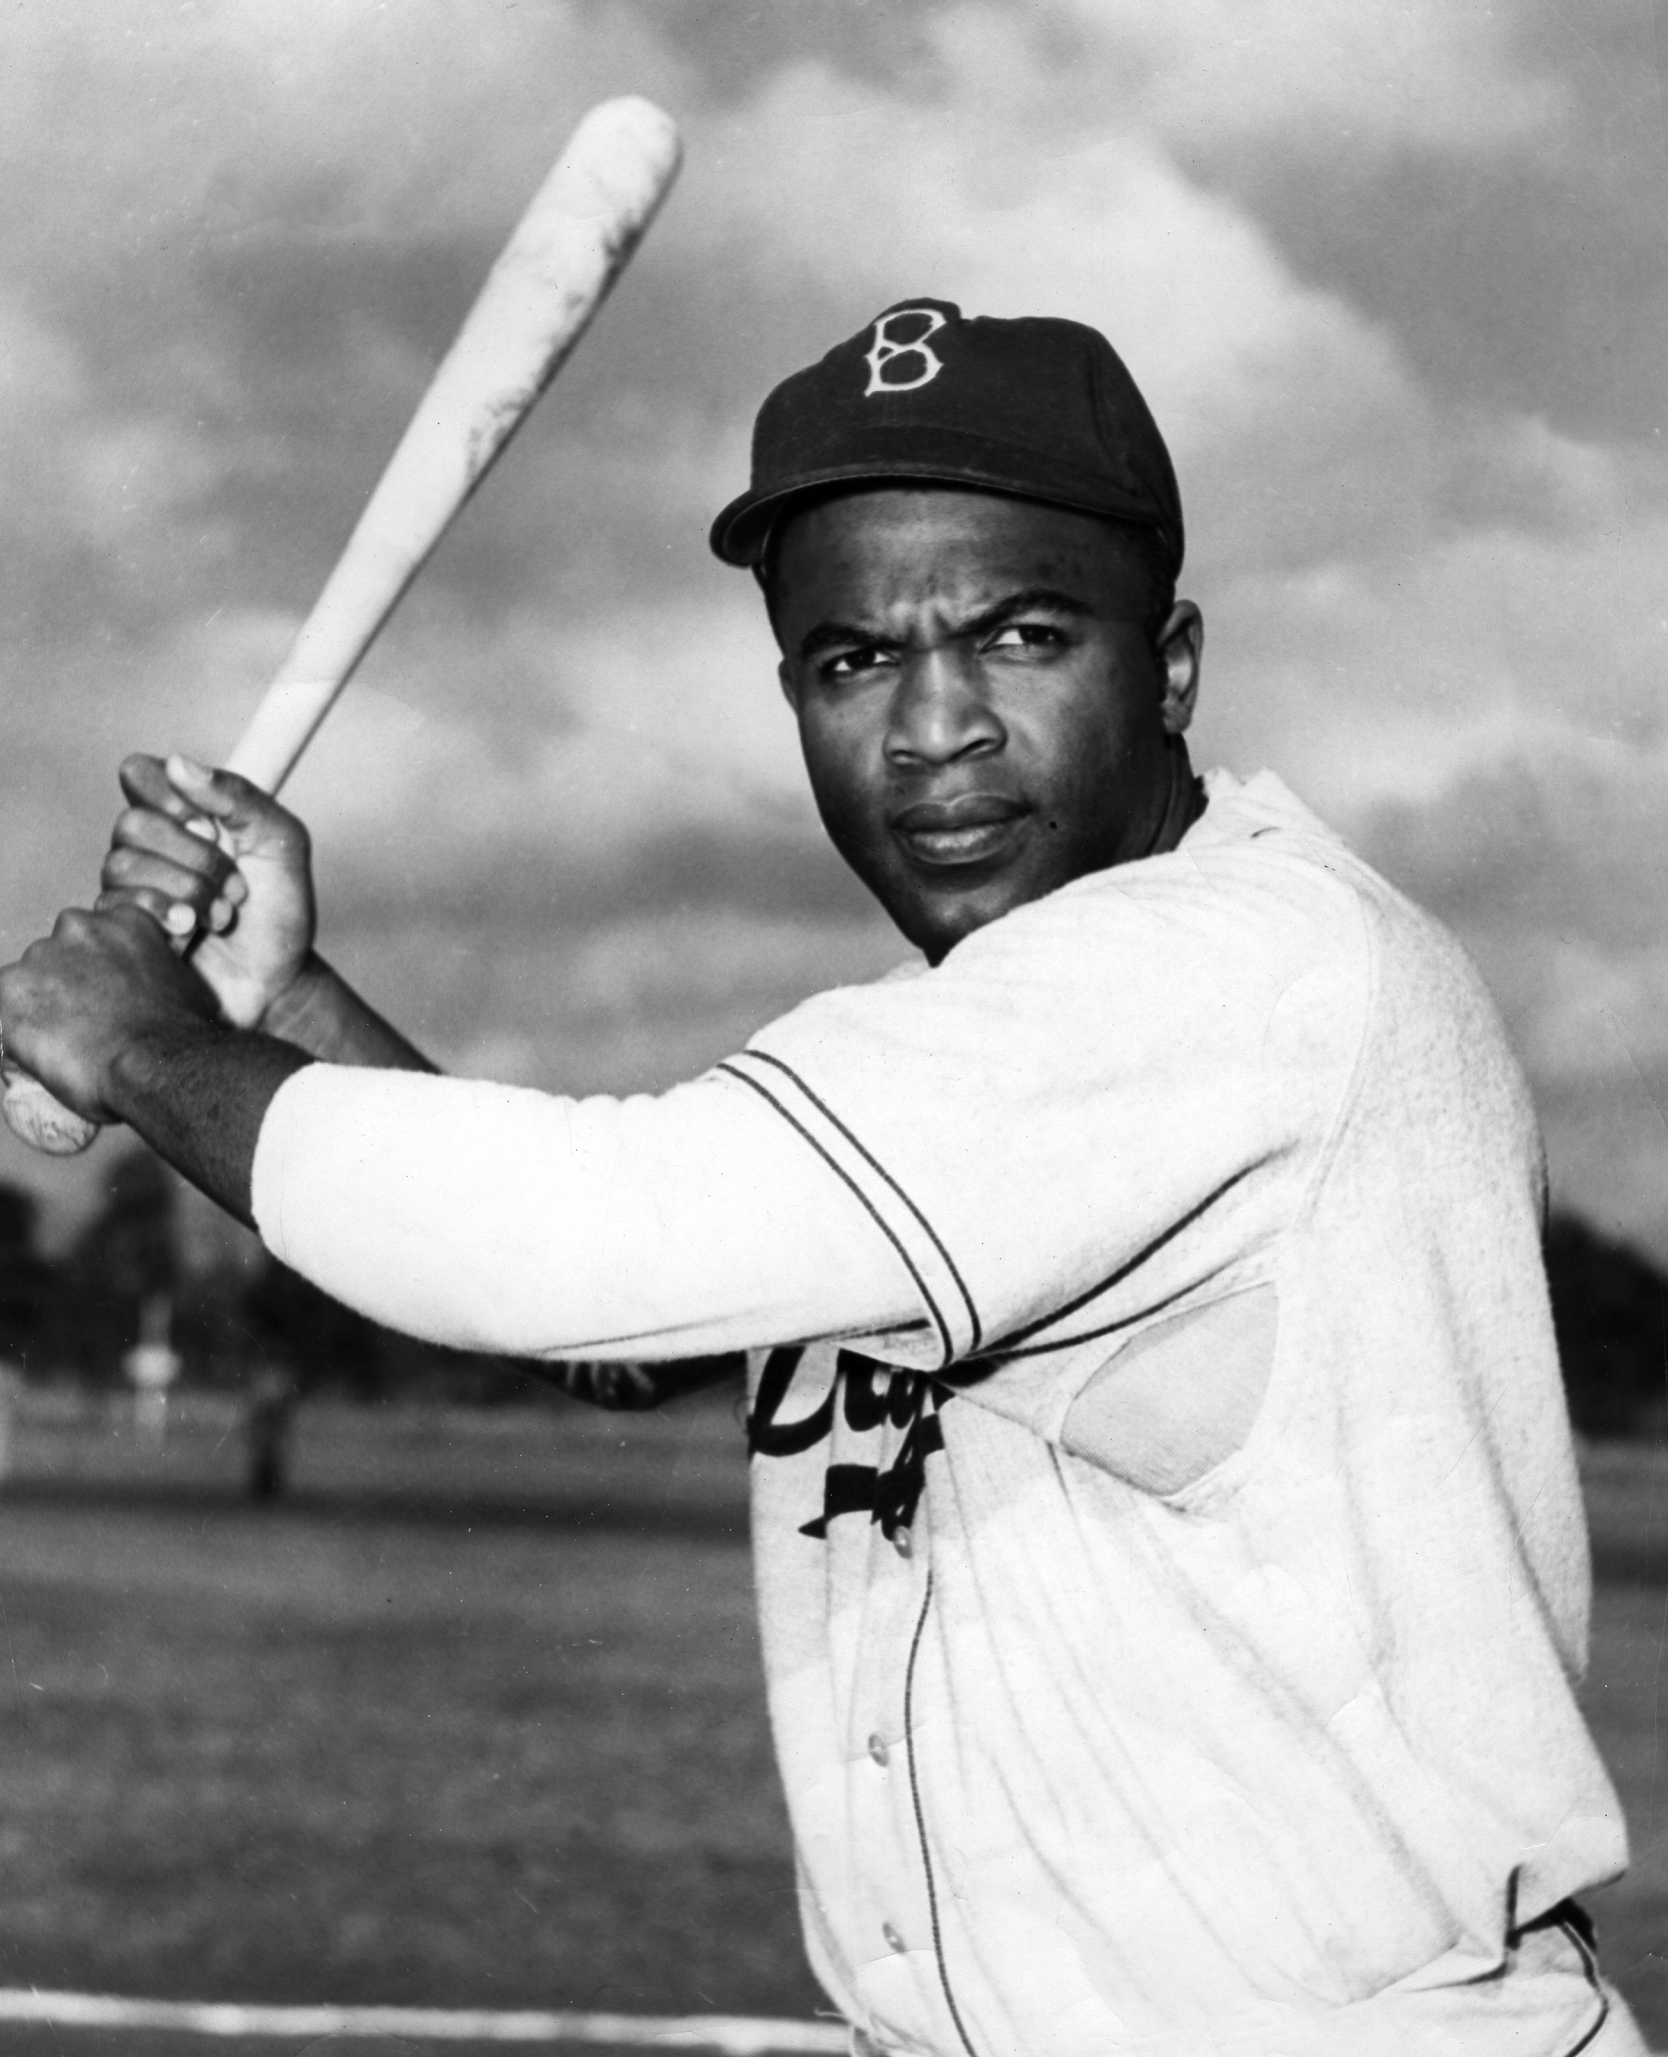
PURPOSE
The rise of the Latino players
The decline of African American players?
Baseball Demographics, 1947-2016

Slide 3
CONT’
Was there a reason for the decline of black American?
Was it the same for minority?
How does WAR come into play?
Data Set- Baseball Demographics, 1947-2016
Research paper by Mark Amour & Daniel Levitt’s

Slide 4
Baseball Demographics 1947-2016
Mark Amour & Daniel Levitt’s research
Numerically defines the spread of integration
Identified players who played in the 1947-1986 period (40 years)
The decline of African American in major leagues
Players who played from 1947 -2016

Slide 5
Lifting Color barrier
The overall percentages of various demographics in baseball
  African American
  Latino
  Asian
  White
  Increase in prayer per team due to increase in pitchers

Slide 6
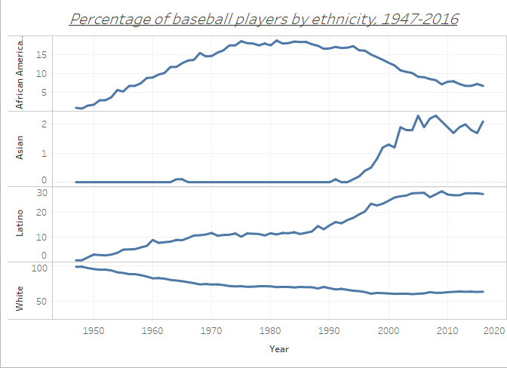

Slide 7
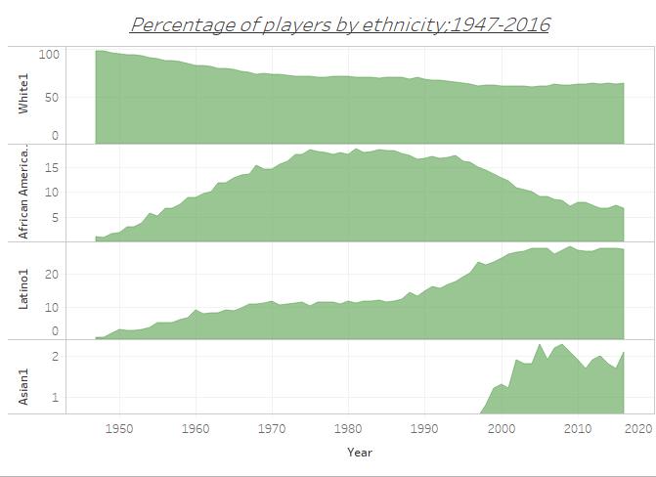

Slide 8
Decline In African American Players
Data presented since 1947
A steady increase up to 1970
Decline exacerbated by increased share of roster sports
Demand trend present at all position
Asians and Latinos also increased steadily

Slide 9
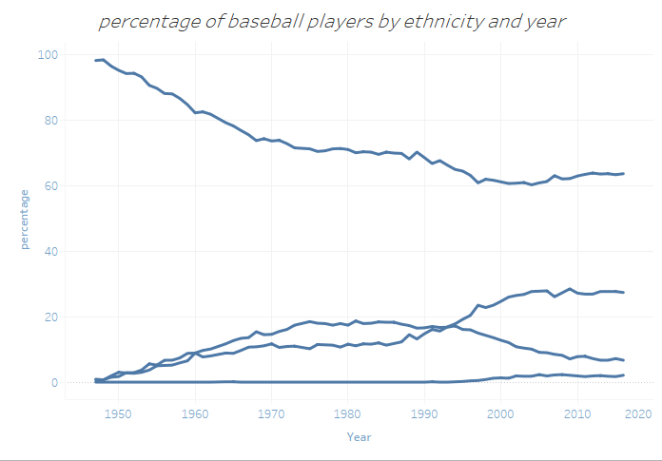
whites
Latino
African American
Asians

Slide 10
Reference
Baseball Demographics, 1947-2016 | Society for American Baseball Research. (2018). Sabr.org. Retrieved 27 March 2018, from https://sabr.org/bioproj/topic/baseball-demographics-1947-2012

